Slide 1

DataKind
Housing Insecurity

Slide 2
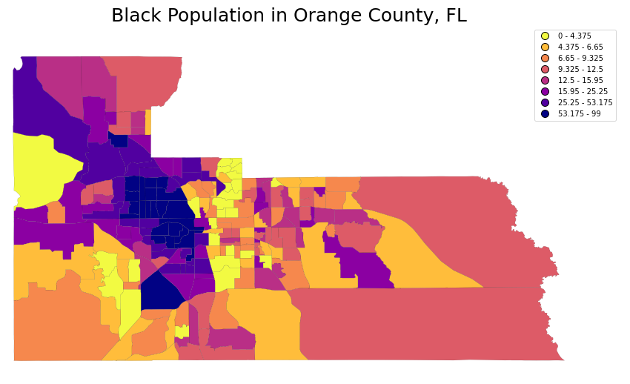
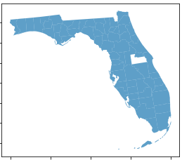
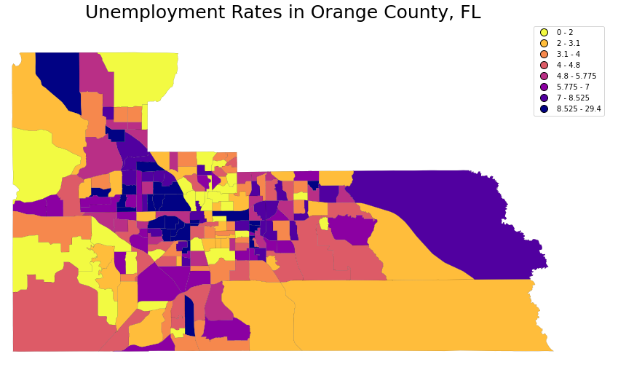
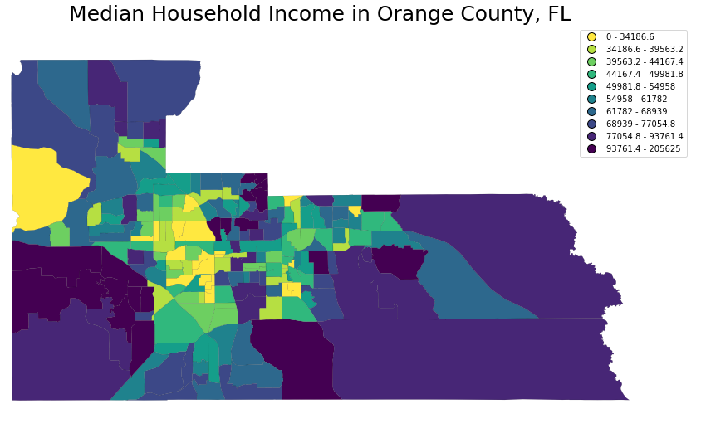
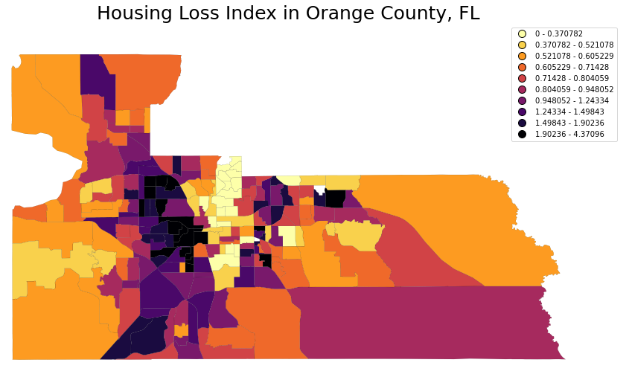
Orange County, FL
Housing loss in neighborhoods (predominately African-American) with low income and high unemployment

Slide 3
Key Findings about population in Orange County (2014-2019)
There was a 10% increase in widowed/ divorced women
Family size has shrunk 20% in five years
Baby boom 35% increase
10% increase in grandparents living with grandchildren
10% increase in disability
Conclusion
The key findings point to future challenges. Single mothers, higher fertility, and their children living with grandparents but they are not correlated with displaced housing
Displaced housing affects races unequally, and follows pattern of low income, high unemployment.

